Slide 1

Presentation
ON
Student Progress Report
follow
history
services
teams
timeline
about
Under The Guidance of
Mrs. Shweta Banerjee
Submitted by:
Krishna Kamal Mandal
Chayan Chakraborty
Shinchan Chowdhury
Anamitra Ghosh
Subhajit Adhikary

Slide 2
Contents
follow
history
Objective
DFD
ER Diagram
Future Scope
Conclusion
services
teams
timeline
about
Introduction

Slide 3
Problem Definition
WELCOME
Student Progress Report is web application software which is helpful for school & college authorities.
In the current system all the activities are done manually.
Time consuming
Complex for maintenance
history
FREE POWERPOINT TEMPLATE
follow
Introduction
services
teams
timeline
DESIGNED BY POWERPOINT SCHOOL

Slide 4
PURPOSE
WELCOME
Student Progress Report (SPR) is web-based application software designed to :
Introduce a conducive and structured information exchange.
Environment for integrating students, parents, teachers and the administration of a school or college.
FREE POWERPOINT TEMPLATE
Objective
follow
timeline
Introduction
services
teams
DESIGNED BY POWERPOINT SCHOOL

Slide 5
OBJECTIVE FULFILLED BY CURRENT SYSTEM
WELCOME
Student Progress Report (SPR) is able to perform following task:
Record of students details
Marks entry
Attendance record
Pie Chart Generation
Guider Suggestion by System
FREE POWERPOINT TEMPLATE
Objectives
follow
Introduction
services
teams
Overview
DESIGNED BY POWERPOINT SCHOOL

Slide 6
DATA FLOW DIAGRAM
WELCOME
A Data Flow Diagram (DFD) is a diagram that describes the flow of data and the processes that change data throughout a system. A structured analysis and design tool that can be used for flowcharting in place of or in association with information.
FREE POWERPOINT TEMPLATE
Overview
Objectives
follow
Introduction
services
DFD
DESIGNED BY POWERPOINT SCHOOL

Slide 7
DATA FLOW DIAGRAM
WELCOME
Process
Entity
FREE POWERPOINT TEMPLATE
Overview
Objectives
follow
Introduction
services
DFD
Data Flow
DESIGNED BY POWERPOINT SCHOOL
Output
Storage

Slide 8
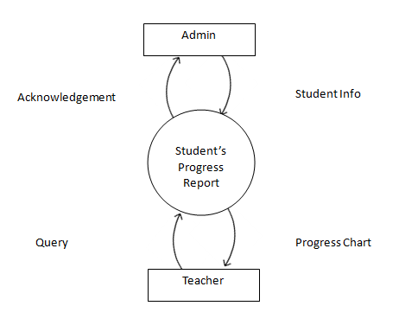
CONTEXT LEVEL
WELCOME
FREE POWERPOINT TEMPLATE
Overview
Objectives
follow
Introduction
services
DFD
DESIGNED BY POWERPOINT SCHOOL

Slide 9
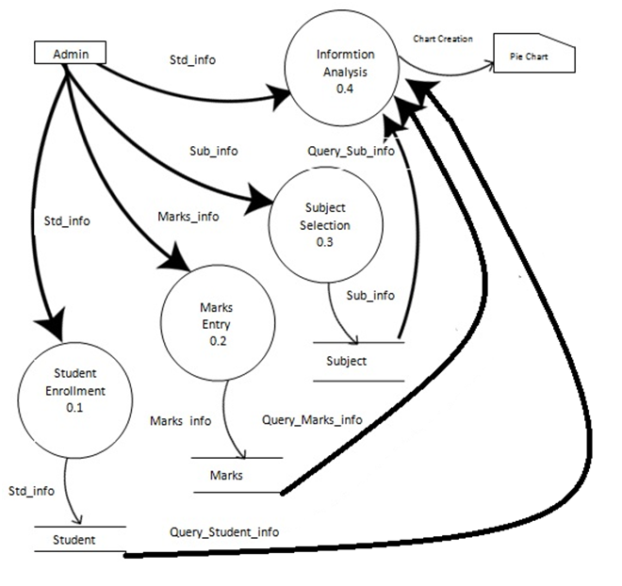
LEVEL 1
WELCOME
FREE POWERPOINT TEMPLATE
Overview
Objectives
follow
services
DFD
Introduction
DESIGNED BY POWERPOINT SCHOOL

Slide 10
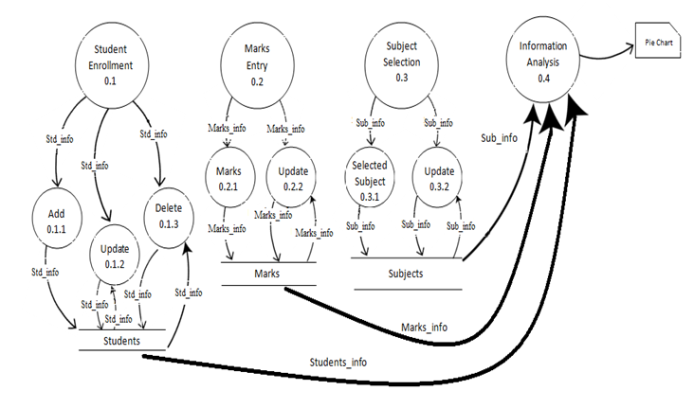
LEVEL 2
WELCOME
FREE POWERPOINT TEMPLATE
Overview
Objectives
follow
DFD
Introduction
services
DESIGNED BY POWERPOINT SCHOOL

Slide 11
ENTITY-RELATIONSHIP DIAGRAM
WELCOME
An Entity–relationship model (ER model for short) describes interrelated things of interest in a specific domain of knowledge. A basic ER model is composed of entity types and specifies relationships that can exist between instances of those entity types.
FREE POWERPOINT TEMPLATE
Overview
Objectives
follow
ERDiagram
Introduction
DFD
DESIGNED BY POWERPOINT SCHOOL

Slide 12
ENTITY-RELATIONSHIP DIAGRAM
Relationship
Attribute
Key Attribute
WELCOME
Entity
Multivalued
Attribute
Attribute1
Composite
Attribute
FREE POWERPOINT TEMPLATE
Overview
Objectives
follow
ERDiagram
Introduction
DFD
DESIGNED BY POWERPOINT SCHOOL
Attribute2
Link Representation

Slide 13
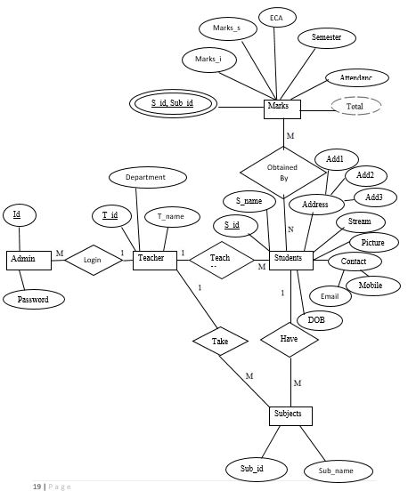
ENTITY-RELATIONSHIP DIAGRAM
WELCOME
FREE POWERPOINT TEMPLATE
Overview
Objectives
follow
ERDiagram
Introduction
DFD
DESIGNED BY POWERPOINT SCHOOL

Slide 14
FUTURE SCOPE
WELCOME
The aim of the proposed system is to develop a system of improved facilities.
Minimize manual data entry
Proper control of higher officials
Biometric Features
follow
FREE POWERPOINT TEMPLATE
Overview
Objectives
Scope
Introduction
DFD
DESIGNED BY POWERPOINT SCHOOL

Slide 15
CONCLUSION
WELCOME
It is always prudent to opt for a student record maintenance that is designed using modern system architecture to cope with changing requirements.
Easy Pie chart creation
Overall progression of students
Tracking of extra curricular activities
Better conduction of students by teachers
FREE POWERPOINT TEMPLATE
Conclusion
Overview
Objectives
Scope
Introduction
DFD
DESIGNED BY POWERPOINT SCHOOL

Slide 16

WELCOME
FREE POWERPOINT TEMPLATE
Thank You
Overview
Conclusion
Objectives
Scope
Introduction
DFD
DESIGNED BY POWERPOINT SCHOOL

